Slide 1
Statistical Methods for Data Analysis hypothesis testing
Luca Lista
INFN Napoli

Slide 2
Contents
Hypothesis testing
Neyman-Pearson lemma and likelihood ratio
Multivariate analysis (elements)
Chi-square fits and goodness-of-fit
Confidence intervals
Feldman-Cousins ordering

Slide 3
Hypothesis testing
The problem from the point of view of a physicist:
  A data sample is characterized by n variables, (x₁, …, x_{n}), with different distributions for two cases possible process: signal, and background
  Given a measurement (= event) of the n variables having discriminating power, identify (discriminate) the event as coming from signal or background
    Clearly, the identification sometimes gives the correct answer, sometimes gives the wrong answer
Property of discriminator:
  Selection efficiency: probability to correctly identify signal events
  Misidentification probability: probability to misidentify as a background event
  Purity: fraction of signal in a positively identified sample
    Depends on the signal and background composition! It is not a property of the discriminator only
  Fake rate: fraction of background in a positively identified sample, = 1 − Purity

Slide 4
Terminology
Statisticians’ terminology is sometimes not very natural for physics applications, but it has become popular among physicists as well:
H₀ = null hypothesis
  Ex. 1: “a sample contains only background”
  Ex. 2: “a particle is a pion”
H₁ = alternative hypothesis
  Ex. 1: “a sample contains background + signal”
  Ex. 2: “a particle is a muon”
Test statistic: a variable computed from our sample that discriminates between the two hypotheses H₀ and H₁. Usually a ‘summary’ of the information available in the sample
α = significance level: probability to reject H₁ if H₀is assumed to be true (error of first kind, false positive)
  α = 1 – misidentification probability
  β = misidentification probability, i.e.: probability to reject H₀ if H₁ is assumed to be true (error of second kind, false negative)
  1 – β = power of the test = selection efficiency
p-value: probability, assuming H₀, of observing a result at least as extreme as the observed test statistic

Slide 5
Cut analysis
Cut on one (or more) variables:
  If x ≤ x_{cut} ⇒ signal
  Else, if x > x_{cut} ⇒ background
Efficiency (1−α)
Mis-id probability(1-β)
x_{cut}
x

Slide 6
Variations on cut analyses
Cut on multiple variables
  AND/OR of single cuts
Multi-dimensional cuts:
  Linear cuts
  Piece-wise linear cuts
  Non-linear combinations
At some point, hard to find optimal cut values, or too many cuts required
  How to determine the cuts, looking at control samples?
  Control samples could be MC, or selected data decays
  Note: cut selection must be done a-priori, before looking at data, to avoid biases!

Slide 7
Efficiency vs mis-id
Varying the applied cut on the test statistic both the efficiency and mis-id probability change
1
Efficiency (1 − α)
x_{cut}
0
0
1
Mis-id prob. (β)
Sometimes also referred to as ROC curve (Receiver Operating Characteristic)

Slide 8
Performance comparison
One test is preferable to another if, for the same level of efficiency (1 − α), it has lower mis-id probability (β)
1
Efficiency (1 − α)
1−α
x_{cut}
Note: sometimes ROC curves may also cross!
0
0
β
<
βʹ
1
Mis-id prob. (β)

Slide 9
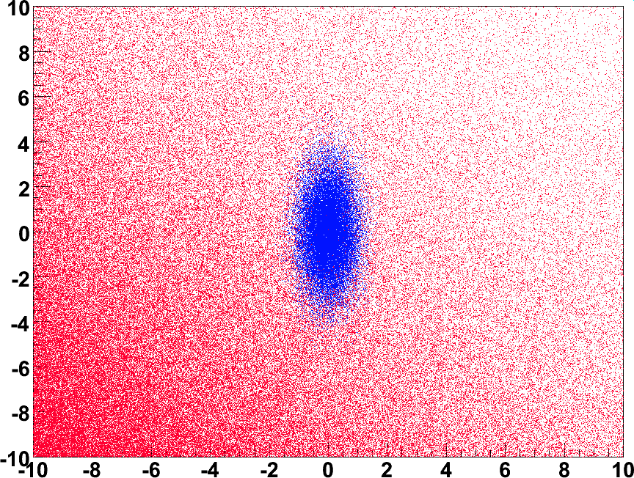
Straight cuts or something else?
Straight cuts may not be optimal in all cases

Slide 10
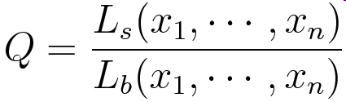
Likelihood ratio discriminator
We make the ratio of likelihoods defined in the two hypotheses:
Q may also depend on a number of unknown parameters (θ₁,…,θ_{N})
Best discriminator, if the multi-dimensional likelihood is perfectly known (Neyman-Pearson lemma)
Great effort in getting the correct ratio
  E.g.: Matrix Element Tecnhniques for top mass and single-top at Tevatron
Notes:
Q = \frac{L_s(x_1, \cdots, x_n)}{L_b(x_1, \cdots, x_n)}} = \frac{\prod_{i=1}^n f_s^i(x_i)}{\prod_{i=1}^n f_b^i(x_i)}

Slide 11
Neyman-Pearson lemma
Fixing the signal efficiency (1− α), a selection based on the likelihood ratio gives the lowest possible mis-id probability (β):
λ(x) = L(x|H₁) / L(x|H₀) > k_{α}
If we can’t use the likelihood ratio, we can choose other discriminators, or “test statistics”:
A test statistic is any function of x (like λ(x)) that allows to discriminate the two hypotheses
Neural networks, boosted decision trees are example of discriminators that may closely approximate the performances of Neyman-Pearson limit

Slide 12
Multivariate discrimination
In general, when we consider algorithms that provide a test statistic for samples with multiple variables we talk about multivariate discriminators
  Simple mathematical algorithms exist, as well as complex implementation based on extensive CPU computations
In general, the algorithms are ‘trained’ using input samples whose nature is known (training samples)
  I.e.: where H₀ or H₁ is know to be true
  Example: use data samples simulated with computer algorithms (Monte Carlo)
Some of the most common problems:
  The size of samples is finite, hence the true distributions for the considered hypotheses can’t be determined exactly
  The distribution of the input samples does not reproduce exactly the true distribution of real data (e.g.: systematic uncertainties)

Slide 13
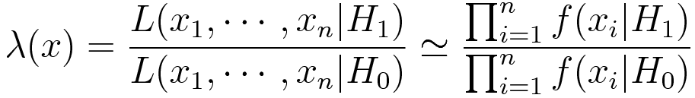
Likelihood factorization
We make the ratio of likelihoods defined in the two hypotheses assuming PDF factorized as product of 1-D PDF:
Approximate in case of non perfectly factorized PDF
  E.g.: correlation
A rotation or other judicious transformations in the variables’ space may be used to remove the correlation
  Sometimes even different for s and b hypotheses
x₁, …, x_{n} approximately considered independent variables
Notes:
Q = \frac{L_s(x_1, \cdots, x_n)}{L_b(x_1, \cdots, x_n)}} = \frac{\prod_{i=1}^n f_s^i(x_i)}{\prod_{i=1}^n f_b^i(x_i)}

Slide 14
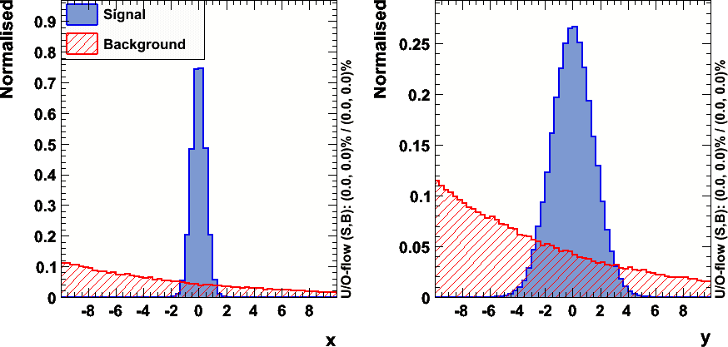
Building projective PDF’s
PDF’s for likelihood discriminator
  If not uncorrelated, need to find uncorrelated variables first, otherwise plain PDF product is suboptimal

Slide 15
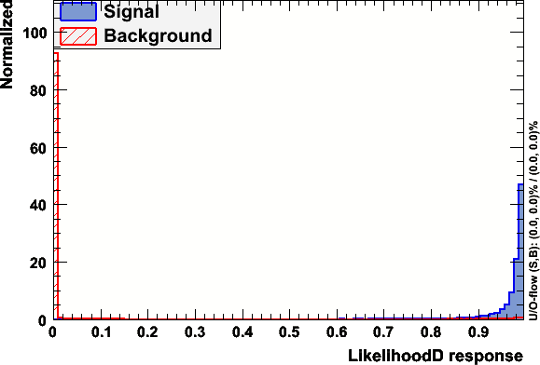
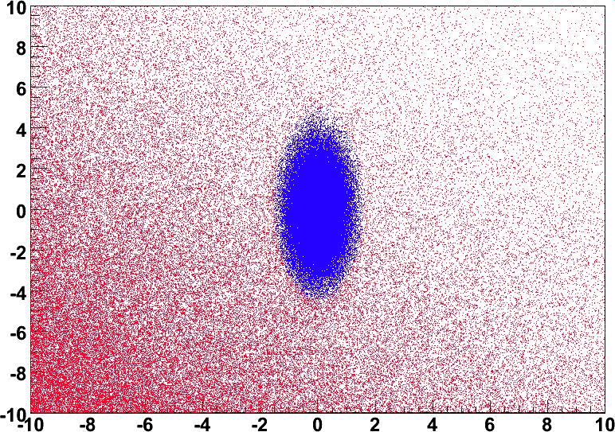
Likelihood ratio output
Good separation achieved in this case
TMVA
L > 0.5

Slide 16
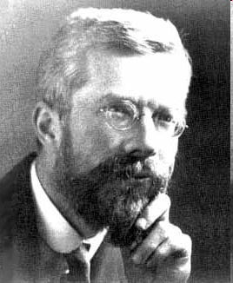
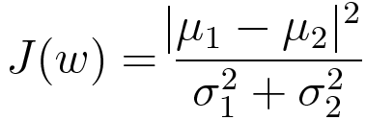
Fisher discriminator
Combine a number of variables into a
single discriminator
Equivalent to project the distribution
along a line
Use the linear combination of inputs that
maximizes the distance of the means of
the two classes while minimizing the
variance within each class:
The maximization problem can be solved with linear algebra
Sir Ronald Aylmer Fisher
(1890-1962)

Slide 17


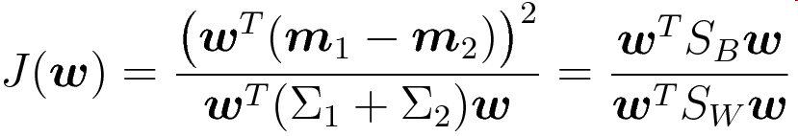
Rewriting Fisher discriminant
m₁, m₂ are the two samples’ average vectors
Σ₁, Σ₂ are the two samples’ covariance matrices
Transform with linear vector of coefficients w
  w is normal to the discriminator hyperplane
“between classes scatter matrix”
“within classes scatter matrix”
Notes:
{\mu_{1}} - {\mu_{2}} = \mbox{\boldmath$w$}^T ({\mbox{\boldmath$m$}_1}-{\mbox{\boldmath$m$}_2})
({\mu_{1}} - {\mu_{2}})^2 = \mbox{\boldmath$w$}^T ({\mbox{\boldmath$m$}_1}-{\mbox{\boldmath$m$}_2})({\mbox{\boldmath$m$}_1}-{\mbox{\boldmath$m$}_2})^T\mbox{\boldmath$w$} = \mbox{\boldmath$w$}^T S_B \mbox{\boldmath$w$}
\sigma_k^2 = \mbox{\boldmath$w$}^T\Sigma_k\mbox{\boldmath$w$}
\sigma_1^2 + \sigma_2^2 = \mbox{\boldmath$w$}^T(\Sigma_1+\Sigma_2)\mbox{\boldmath$w$} = \mbox{\boldmath$w$}^T S_W \mbox{\boldmath$w$}
J(\mbox{\boldmath$w$}) = \frac{\left(\mbox{\boldmath$w$}^T({\mbox{\boldmath$m$}_1}-{\mbox{\boldmath$m$}_2})\right)^2}{\mbox{\boldmath$w$}^T(\Sigma_1+\Sigma_2)\mbox{\boldmath$w$}} = \frac{\mbox{\boldmath$w$}^T S_B \mbox{\boldmath$w$}
}{\mbox{\boldmath$w$}^T S_W \mbox{\boldmath$w$}
}

Slide 18



Maximizing the Fisher discriminant
Either compute derivatives w.r.t. w_{i}
Equivalent to solve the eigenvalues problem:
Notes:
S_W^{-1} S_B \mbox{\boldmath$w$} = \lambda \mbox{\boldmath$w$}
}
\mbox{\boldmath$w$} = S_W^{-1} S_B (\mbox{\boldmath$m$}_1 - \mbox{\boldmath$m$}_2)

Slide 19
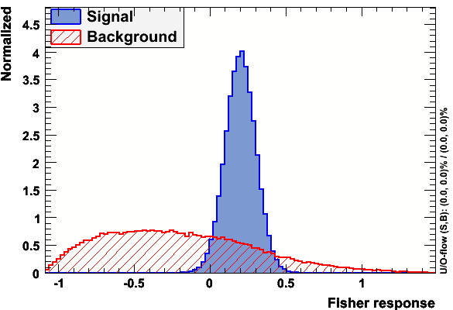
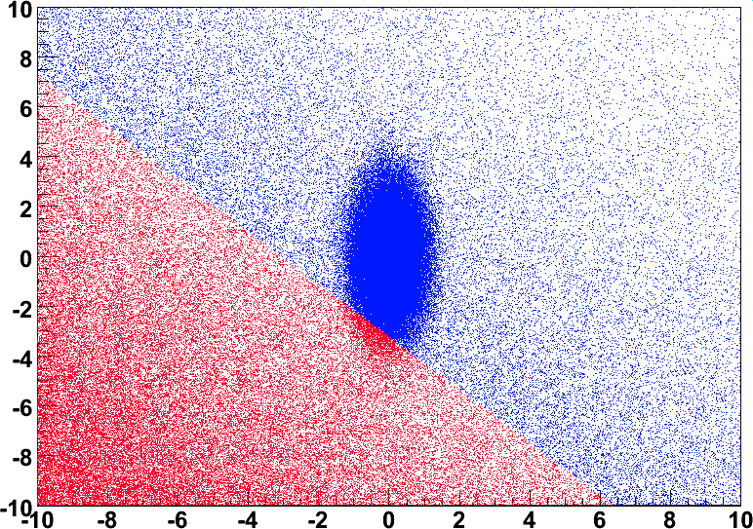
Fisher in the previous example
Not always optimal: it’s linear cut, after all…!
F > 0

Slide 20
Other discriminator methods
Artificial Neural Networks
Boosted Decision Trees
Those topics are beyond the scope of this tutorial
  A brief sketch will be given just for completeness
More details in TMVA package
  http://tmva.sourceforge.net/

Slide 21
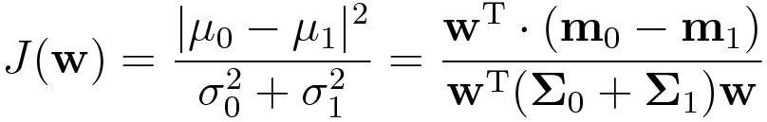
Fisher discriminant
Linear combination of input variables that maximizes the distance of the means of the two classes while minimizing the variance projected along a direction w:
Sir Ronald Aylmer Fisher
(1890-1962)
The selection is achieved by requiring J(w) > J_{cut}, which determines an hyperplane perpendicular to w that separates the two samples
The maximization problem can be solved analytically using linear algebra

Slide 22
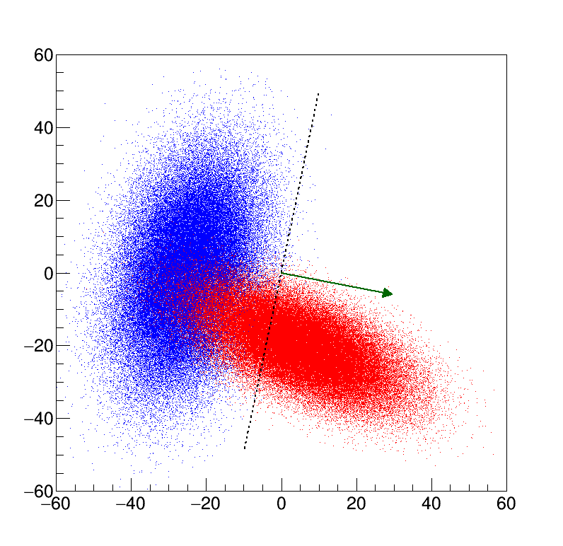

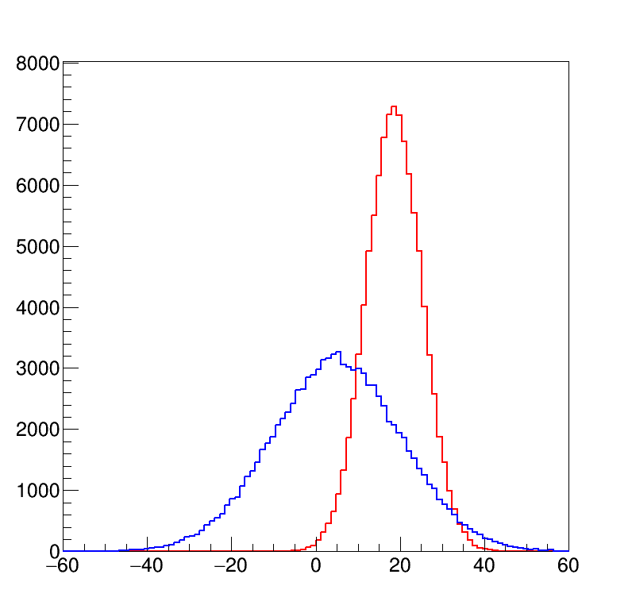
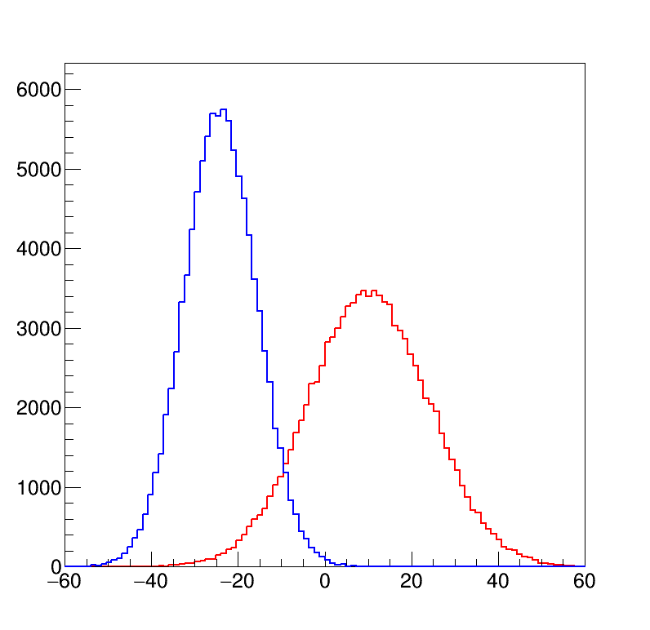
Fisher discriminant
Projections along different directions achieve different overlap level
Maximum separation achieved by maximizing Fisher discriminant

Slide 23
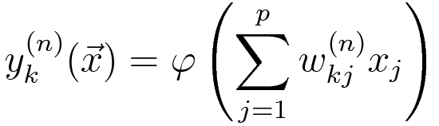
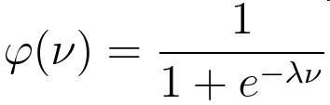
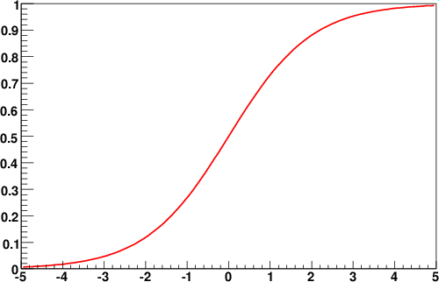
Artificial Neural Networks
Artificial simplified model of how neuron cells work:
multilayer perceptron
Input layer
Hidden layers
w₁₁⁽¹⁾
Output layer
x₁
w₁₁⁽²⁾
w₁₂⁽¹⁾
x₂
w₁₂⁽²⁾
w₁₁⁽³⁾
φ(ν) = Activation function
w₁₂⁽³⁾
x₃
y
…
φ(ν)
w_{2p}⁽³⁾
w_{1p}⁽¹⁾
w_{1p}⁽²⁾
x_{p}
ν

Slide 24
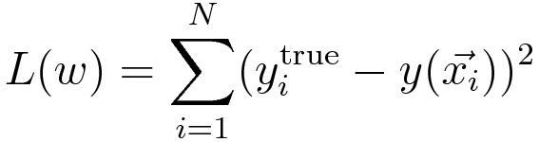
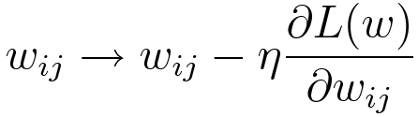
Network training
Find the optimal set of network parameters w_{ij}^{(n)} that minimize the “loss function” defined on a set of N training events:
Where y_{i}^{true} = 1 for signal (H₁), 0 for background (H₀)
Usually achieved with stochastic gradient descent:
weights are modified for each training event (back propagation):
The parameter η controls the learning rate
Variations on the training methods exist

Slide 25
ANN and function modeling
Artificial neural network with a single hidden layer may approximate any analytical function within a given approximation if the number of neurons is sufficiently high
Demonstration in:
  H. N. Mhaskar, Neural Computation, Vol. 8, No. 1, Pages 164-177 (1996), Neural Networks for Optimal Approximation of Smooth and Analytic Functions:
  “We prove that neural networks with a single hidden layer are capable of providing an optimal order of approximation for functions assumed to possess a given number of derivatives, if the activation function evaluated by each principal element satisfies certain technical conditions”
Anyway, the finite number of layer may lead to reaching this goal only approximately
Deep learning: networks with several hidden layers
  Can manage complex variables combinations, e.g.: exploiting invariant mass distributions using four-vectors as input!
  Almost untreatable in the past, a lot of progress has been done recently, with better training algorithms and more easily available CPU power

Slide 26
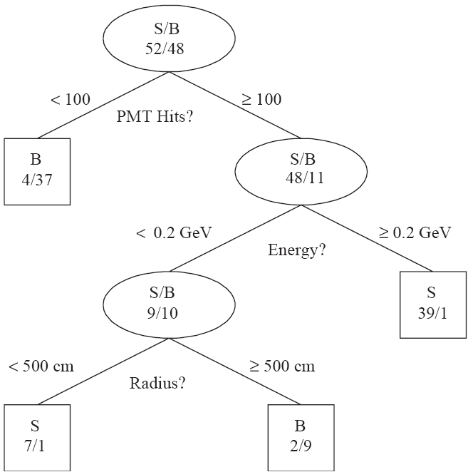
Decision Trees
Branch
Cuts are applied sequentially
Each cut splits the sample into nodes
  Nodes where signal or background is largely dominant are classified as leafs
    Alternatively: stop splitting if too few events per note, total number of nodes too high, …
  One branch = one sequence of cuts
Cuts can be optimized to achieve the best split level: minimize for each node the gain of Gini index:
  G = P(1 − P)
Alternative metrics exist
Branch
Branch
Leaf
G = 0 for nodes with all S or all B events
Leaf
P = node purity
Gain =
N_{parent}G_{parent}−N_{left ch.}G_{left ch.}−N_{left ch.}G_{left ch.}
Leaf
Leaf
E.g.: cross entropy = −(P lnP + (1−P) ln(1−P)), …
Decision tree

Slide 27
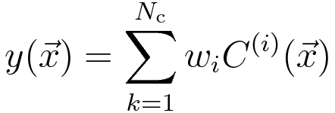
From trees to forests
Boosted Decision Trees
  Combine a large number of decision trees (forest) using different weights. Usually: 𝓞(1000) trees used
  More performant and stable than a single optimized tree
Boosting achieved by iteratively reweighting training sample according to classifier output in previous iteration
Reweight events using previous iteration’s classifier result
Build and optimize a new tree with reweighted events
Give a score to each tree
The final BDT classifier result is the weighted average over all trees, using the given scores as weights:

Slide 28
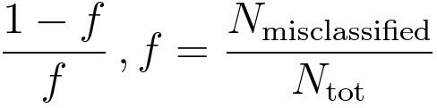
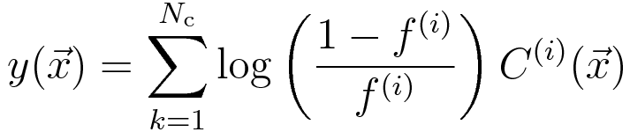
Adaptive boosting
Misclassified events are reweight according to the fraction of classification errors of the previous tree:
Also use (log of) misclassification fraction as score for each tree:
Next iteration will better perform on events poorly classified in the previous iteration
Further variations and more algorithms available

Slide 29
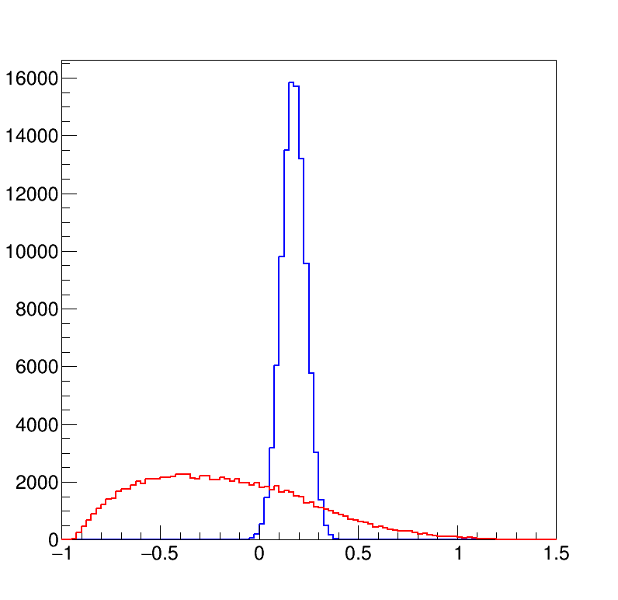
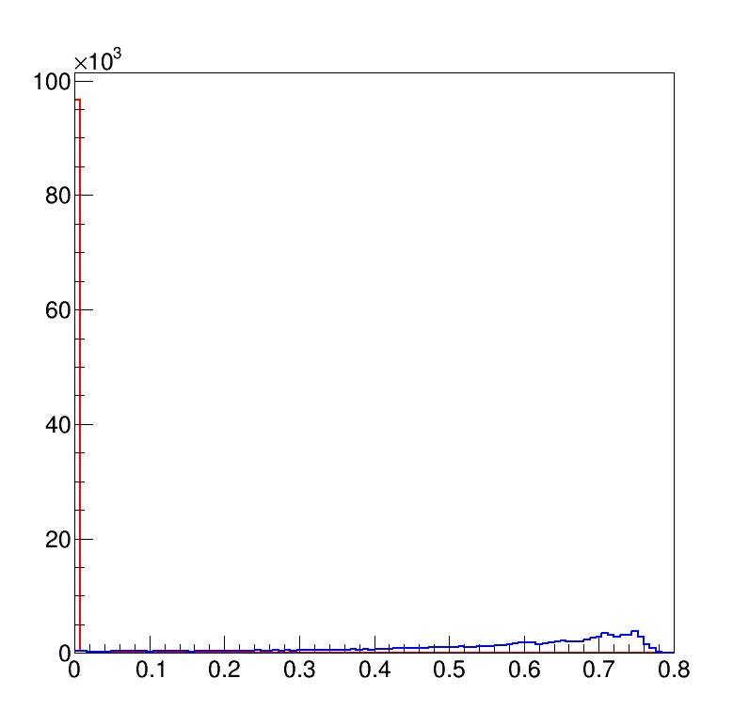
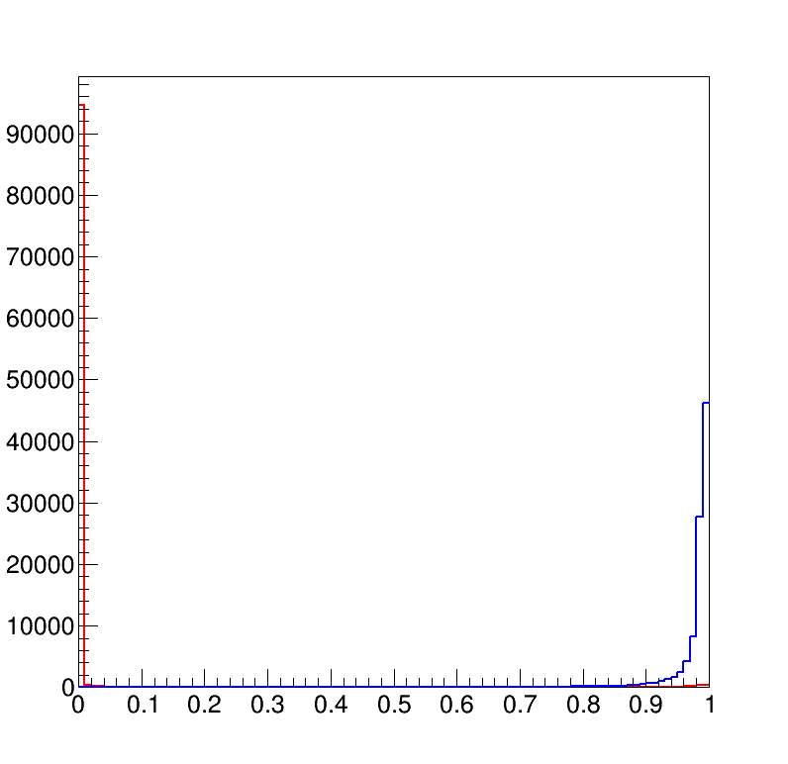
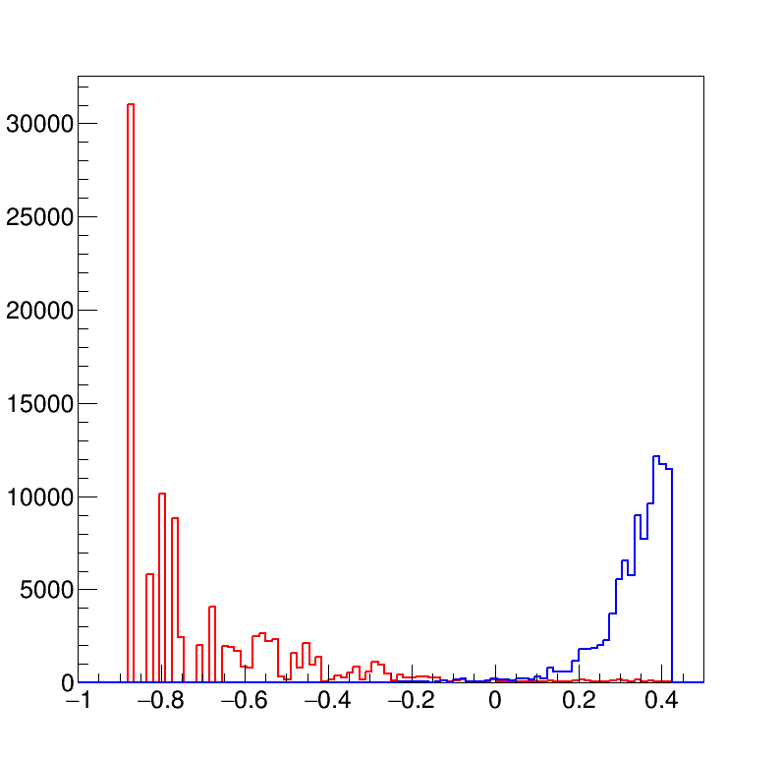
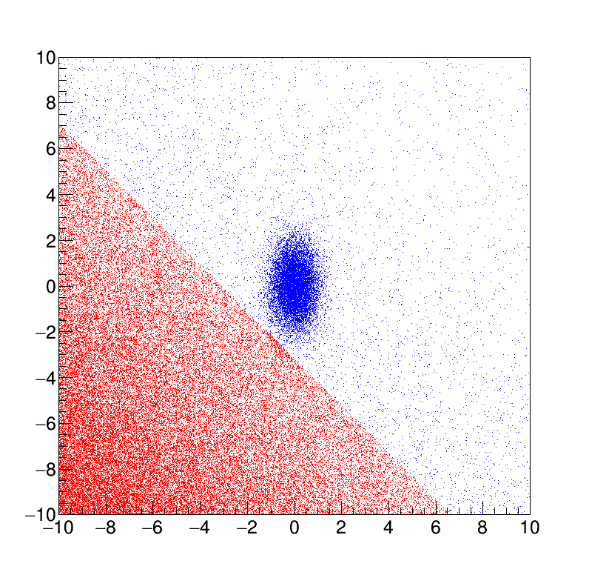
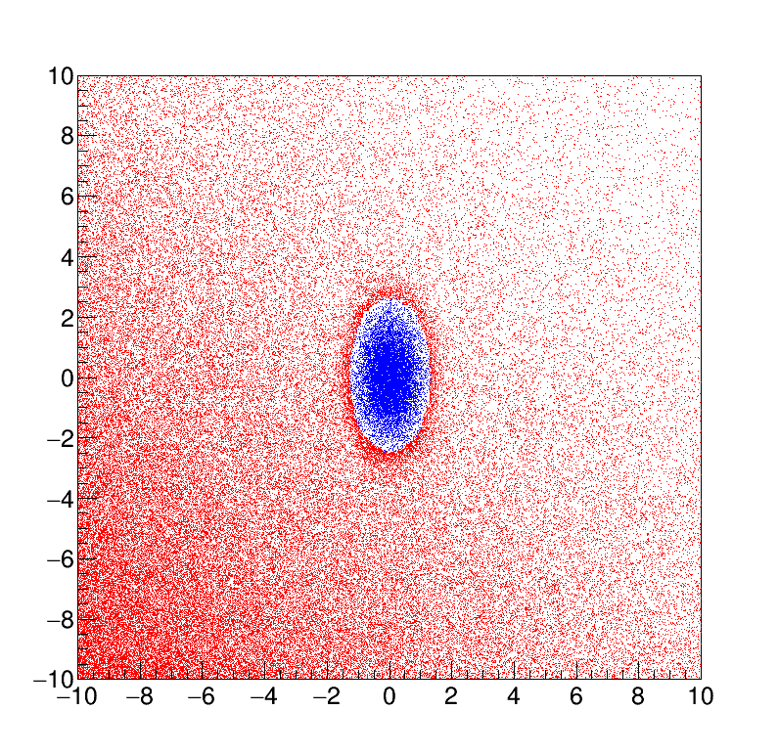
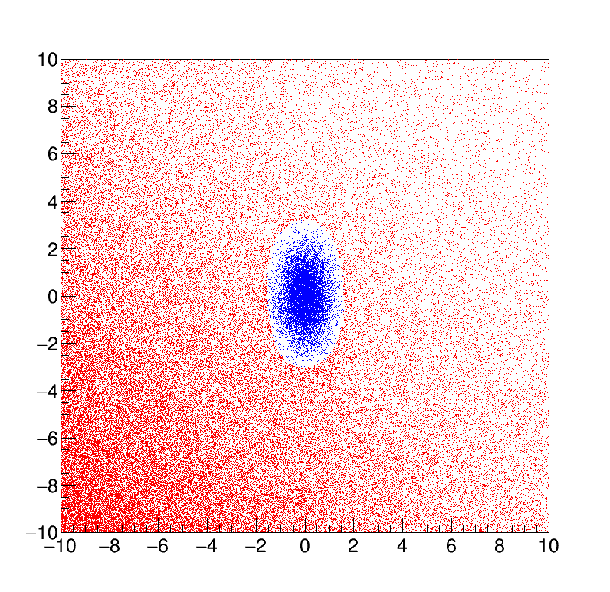

Comparing discriminants
Fisher
Proj. likelihood ratio
Neural Network
BDT
F > 0
L > 0.1
NN > 0.5
BDT > 0.0

Slide 30
Overtraining
Algorithms may learn too much from the training sample, exploiting features that are only due to random fluctuations
Check for overtraining comparing the discriminator’s distributions for the training sample and for an independent test sample (consistent distributions = no overtraining)
y
signal
y
signal
background
background
x
x

Slide 31
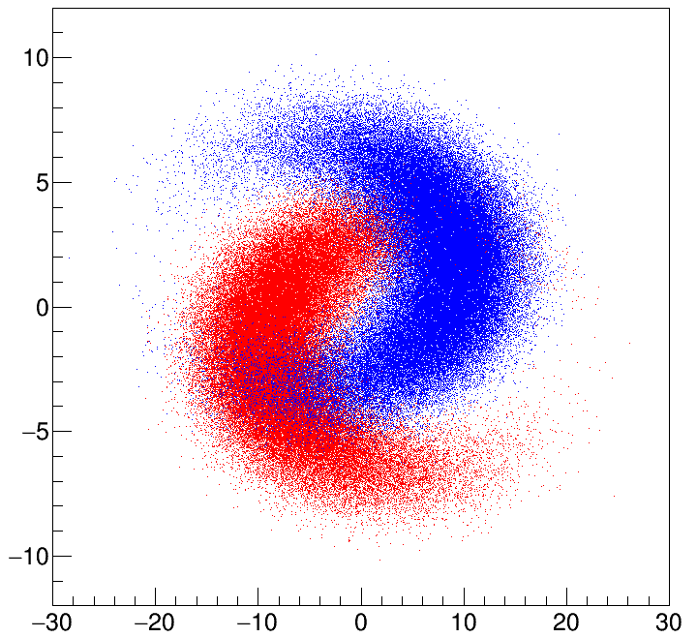
Strongly nonlinear example
y
x

Slide 32
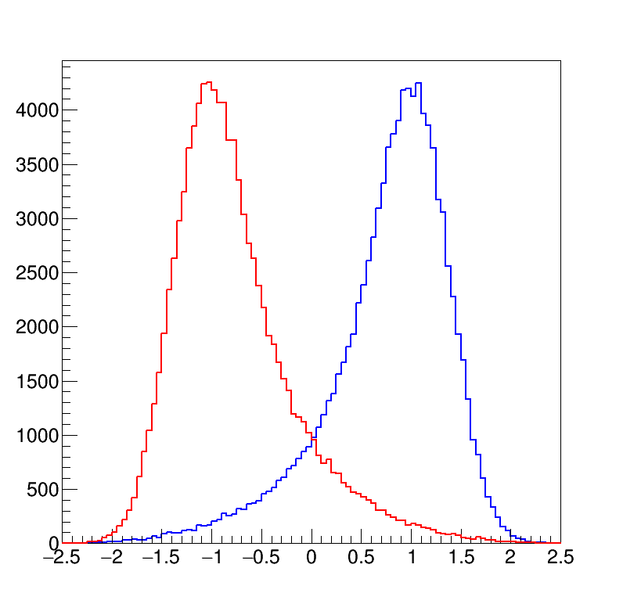
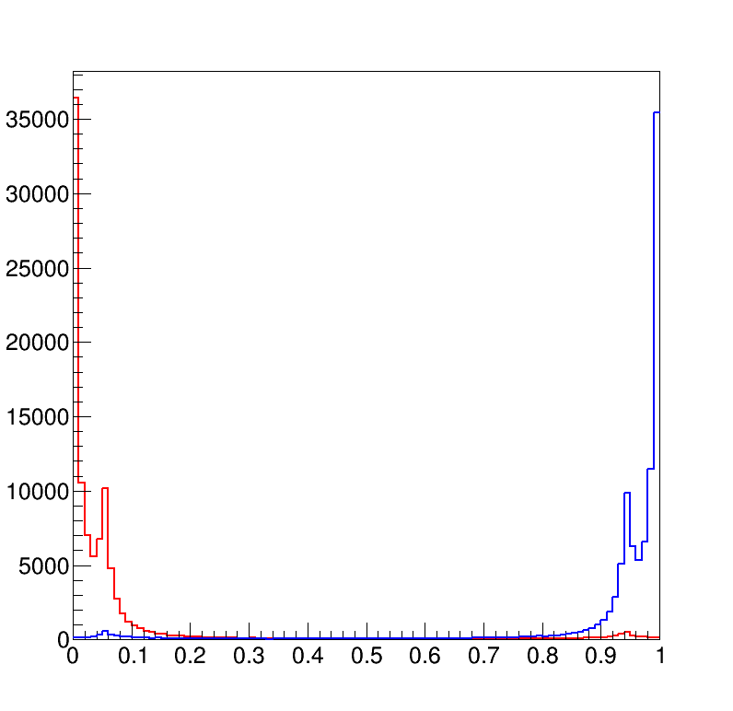
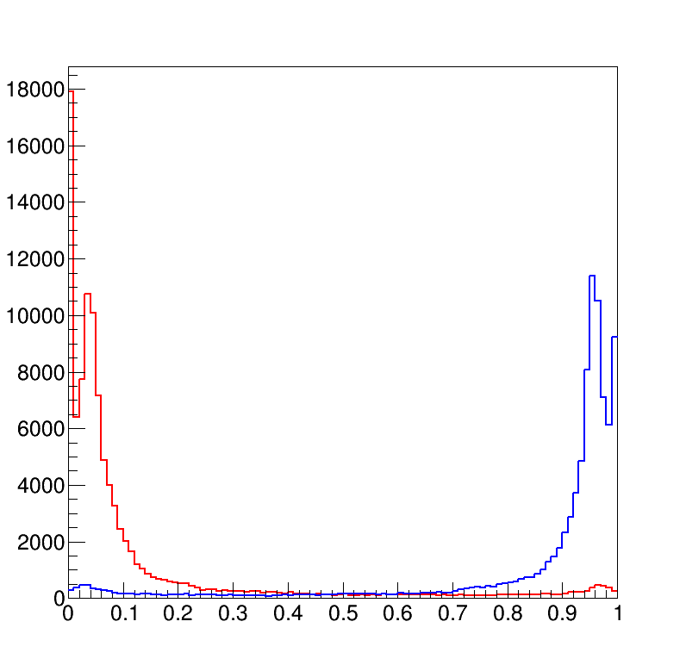
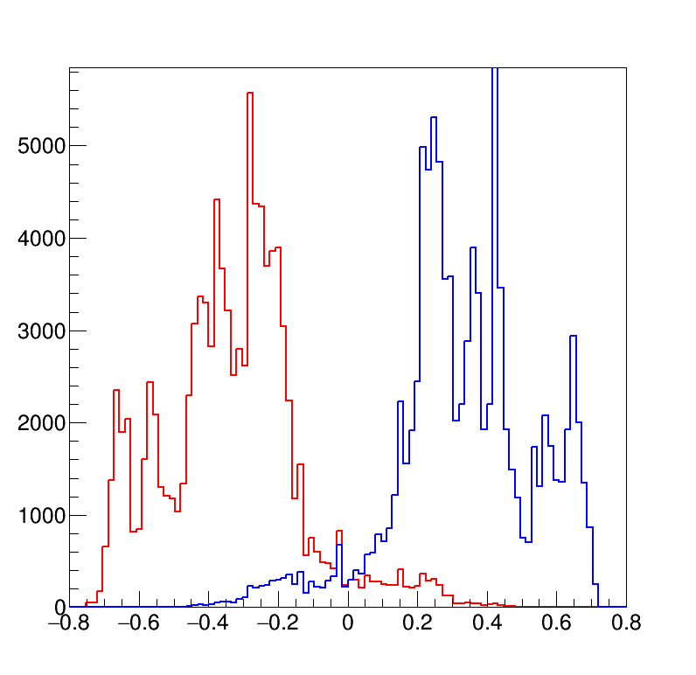
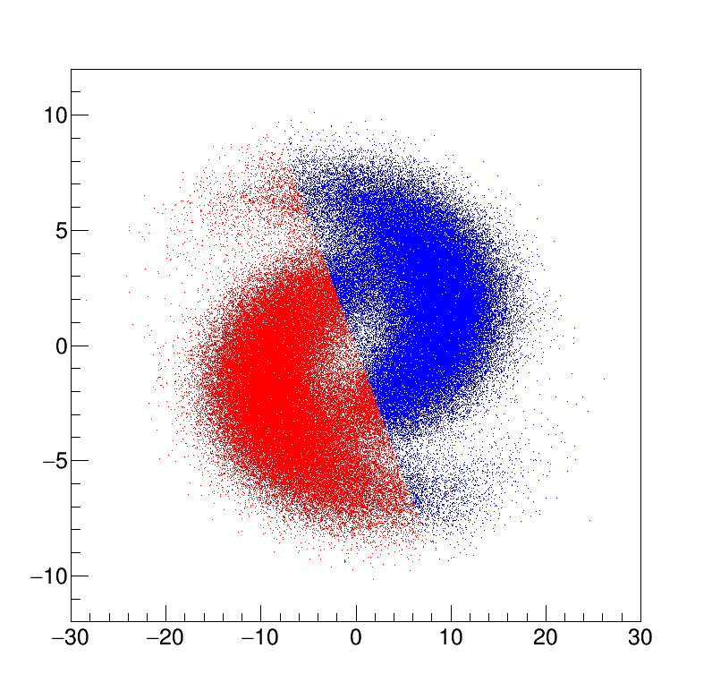
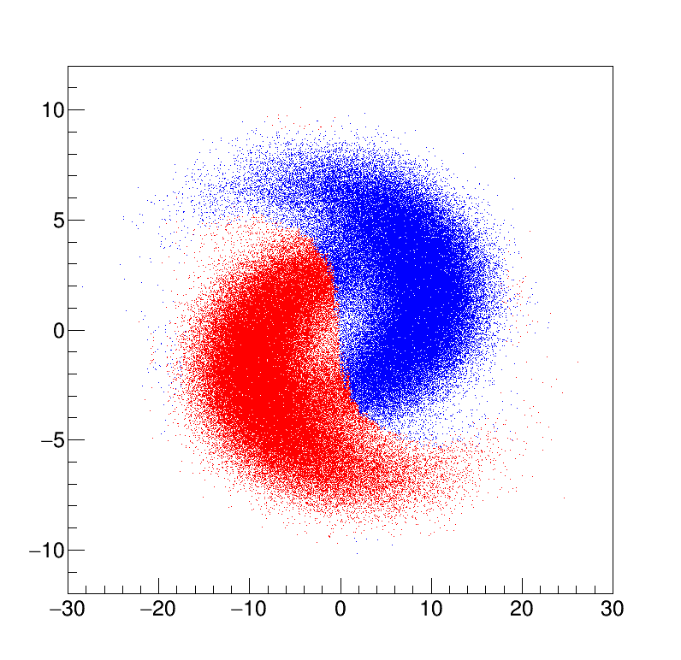
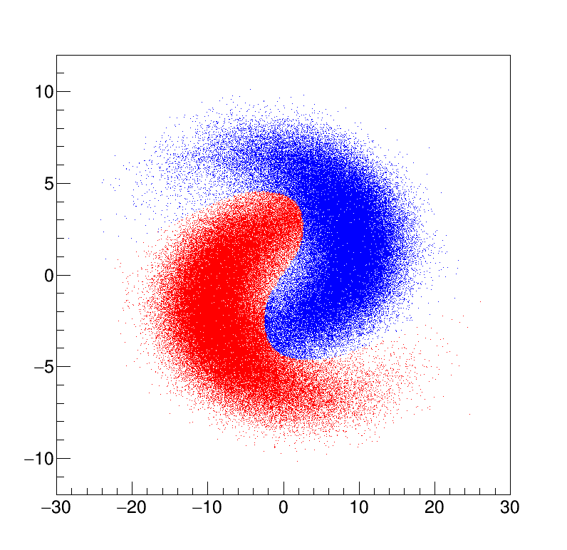

Performances
Fisher
Proj. likelihood ratio
Neural Network
BDT
F > 0
L > 0.5
NN > 0.5
BDT > 0.0

Slide 33
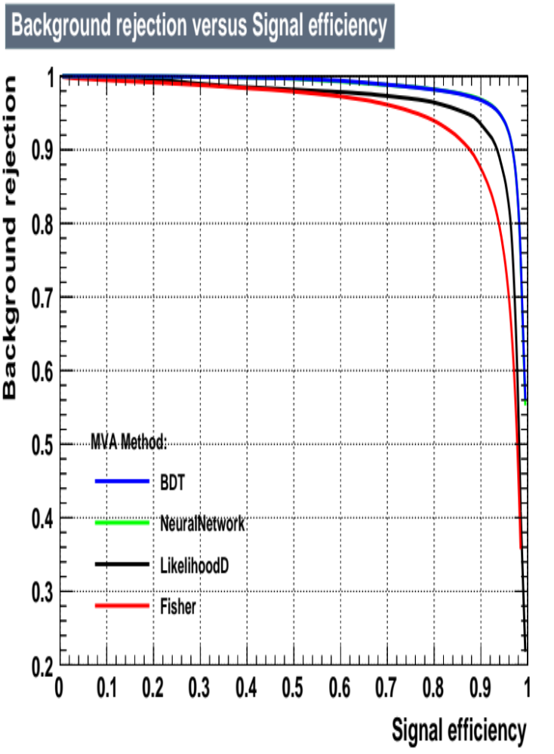
ROC curve
TMVA implementation under ROOT
GUI provided for standard set of plots
ROC curve from the standard TMVA GUI available in ROOT

Slide 34
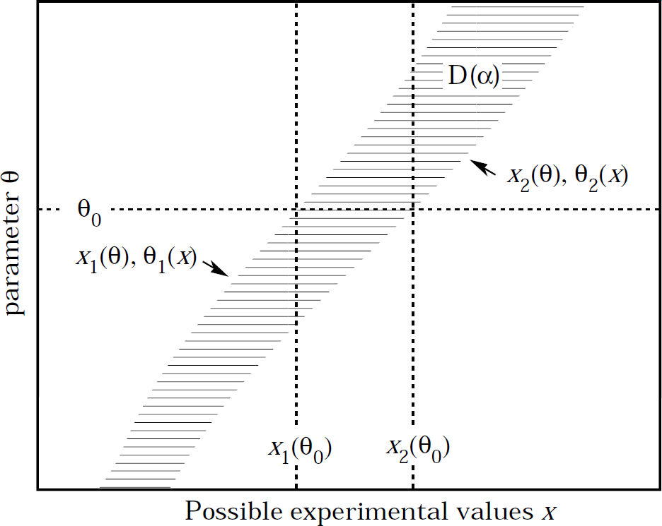
Jerzy Neyman’s confidence intervals
Scan an unknown parameter θ
Given θ, compute the interval [x₁, x₂] that contain x with a probability C.L. = 1−α
Ordering rule needed!
Invert the confidence belt, and find the interval [θ₁, θ₂] for a given experimental outcome of x
A fraction 1−α of the experiments will produce x such that the corresponding interval
[θ₁, θ₂] contains the true value of μ (coverage probability)
Note that the random variables are [θ₁, θ₂], not θ
From PDG statistics review
RooStats::NeymanConstruction

Slide 35
Ordering rule
Different possible choices of the interval giving the same are 1−α are possible
For fixed θ = θ₀ we can have different choices
f(x|θ₀)
f(x|θ₀)
α
α/2
α/2
1−α
1−α
Upper limit choice
x
Central interval
x

Slide 36
Feldman-Cousins ordering
Find the contour of the likelihood ratio that gives an area α
R_{μ} = {x : L(x|θ) / L(x|θ_{best}) > k_{α}}
f(x|θ₀)
f(x|θ₀)/f(x| θ_{best}(x))
1−α
RooStats::FeldmanCousins
x

Slide 37
“Flip-flopping”
When to quote a central value or upper limit?
E.g.:
  “Quote a 90% C.L. upper limit of the measurement is below 3σ;
  quote a central value otherwise”
Upper limit ↔ central interval decided according to observed data
This produces incorrect coverage!
Feldman-Cousins interval ordering guarantees the correct coverage

Slide 38
“Flip-flopping” with Gaussian PDF
Assume Gaussian with a fixed width: σ=1
μ = x ±1.64485
μ
90%
μ < x + 1.28155
10%
5%
5%
5%
x
90%
Central interval
10%
x
Coverage is 85% for low μ!
Upper limit
3
x
Gary J. Feldman, Robert D. Cousins, Phys.Rev.D57:3873-3889,1998

Slide 39


Feldman-Cousins approach
Define range such that:
  P(x|μ) / P(x|μ_{best}(x)) > k_{α}
μ_{best} = max(x, 0)
μ
Usual errors
μ_{best} = x for x ≥ 0
Asymmetric errors
Upper limits
Solution can be found numerically
Will see more when talking about upper limits…
x

Slide 40
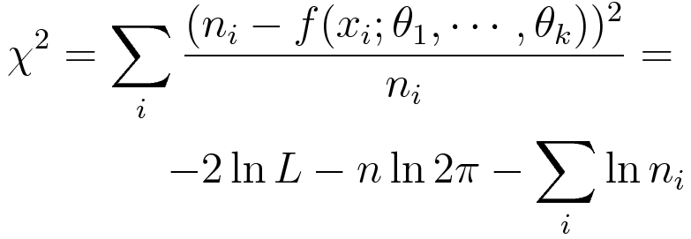
Binned fits: minimum χ²
Bin entries can be approximated by Gaussian for sufficiently large number of entries with std. dev. equal to n_{i} (Neyman):
The expected number of entries μ_{i} is often approximated as the value of a continuous function f at the center x_{i} of the bin:
Denominator n_{i} could be replaced by μ_{i}=f(n_{i}; θ₁, …, θ_{n}) (Pearson)
Usually simpler to implement than un-binned ML fits
Analytic solution exists for linear and other simple problems
Un-binned ML fits unpractical for large sample size
Binned fits can give poor results for small number of entries
Notes:
\chi^2 = \sum_i \frac{(n_i-f(x_i;\theta_1,\cdots,\theta_k))^2}{n_i} =\\
-2\ln L -n\ln 2\pi -\sum_i\ln n_i

Slide 41
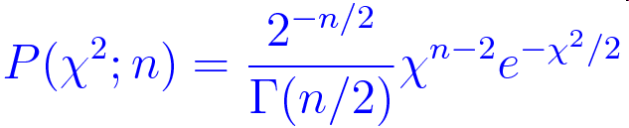
Fit quality
The value of the Maximum Likelihood obtained in a fit w.r.t its expected distributions don’t give any information about the goodness of the fit
Chi-square test
  The χ² of a fit with a Gaussian underlying model should be distributed according to a known PDF
  Sometimes this is not the case, if the model can’t be sufficiently approximated with a Gaussian
  The integral of the right-most tail (P(χ²>X)) is one example of so-called ‘p-value’
Beware! p-values are not the “probability of the fit hypothesis”
  This would be a Bayesian probability, with a different meaning, and should be computed in a different way (→ next lecture)!
n is the number of
degrees of freedom

Slide 42
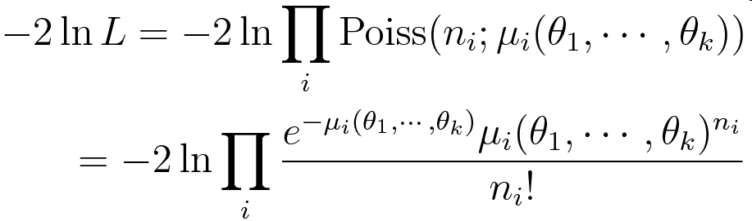
Binned likelihood
Assume our sample is a binned histogram from an event counting experiment (obeying Poissonian statistics), with no need of a Gaussian approximation
We can build a likelihood function multiplying Poisson distributions for the number of entries in each bin, {n_{i}} having expected number of entries depending on some unknown parameters: μ_{i}(θ₁, …θ_{k})
We can minimize the following quantity:
Notes:
-2\ln L = -2 \ln\prod_i\mathrm{Poiss}(n_i;\mu_i(\theta_1,\cdots,\theta_k)) \\
=-2\ln\prod_i\frac{e^{-\mu_i(\theta_1,\cdots,\theta_k)}\mu_i(\theta_1,\cdots,\theta_k)^{n_i}}{n_i!}

Slide 43
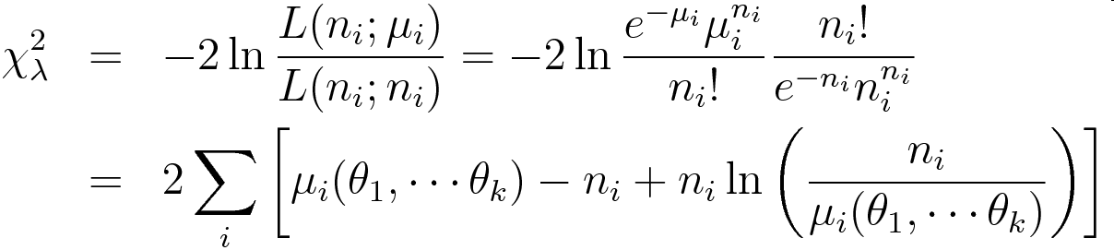
Binned likelihood ratio
A better alternative to the (Gaussian-inspired, Neyman and Pearson’s) χ² has been proposed by Baker and Cousins using the likelihood ratio:
Same minimum value as previous slide, since a constant term has been added to the log-likelihood
It also provides a goodness-of-fit information, and asymptotically obeys chi-squared distribution with k−n degrees of freedom (Wilks’ theorem)
S. Baker and R. Cousins, Clarification of the Use of Chi-square and Likelihood Functions in Fits to Histograms, NIM 221:437 (1984)
Notes:
\chi^2_{\lambda} & = & -2\ln \frac{L(n_i;\mu_i)}{L(n_i;n_i)} = -2 \ln \frac{e^{-\mu_i}\mu_i^{n_i}}{n_i!}\frac{n_i!}{e^{-n_i}n_i^{n_i}}\\ & = & 2\sum_i\left[\mu_i(\theta_1,\cdots\theta_k)-n_i+n_i\ln\left(\frac{n_i}{\mu_i(\theta_1,\cdots\theta_k)}\right)\right]

Slide 44
Toy Monte Carlo
Generate a large number of experiments according to the fit model, with fixed parameters (θ)
Fit all the toy samples as if they where the real data samples
Study the distributions of the fit quantities
Parameter pulls: p_{θ} = (θ^{est} − θ)/σ_{θ}
  Verify the absence of bias: ⟨p_{θ}⟩ = 0
  Verify the correct error estimate : σ(p_{θ}) = 1
Statistical uncertainty will depend on number of the Toy Monte Carlo experiments
Distribution of maximum likelihood (or -2lnL) gives no information about the quality of the fit
Goodness of fit for ML in more than one dimension is still an open and debated issue
Often preferred likelihood ratio w.r.t. a null hypothesis
  Asymptotically distributed as a chi-square
  Determine the C.L. of the fit to real data as fraction of toy cases with worse value of maximum log-likelihood-ratio

Slide 45
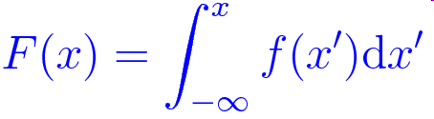
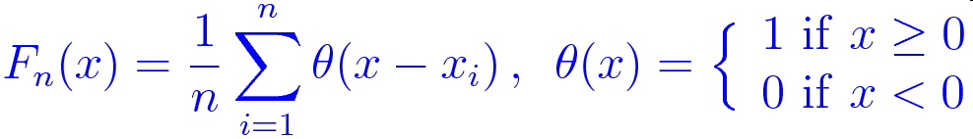

Kolmogorov - Smirnov test
Assume you have a sample {x₁, …, x_{n}}, you want to test if the set is compatible with being produced by random variables obeying a PDF f(x)
The test consists in building the cumulative distribution for the set and the PDF:
The distance between the two cumulative distribution is evaluated as:

Slide 46
Kolmogorov-Smirnov test in a picture
1
D_{n}
F(x)
F_{n}(x)
0
x
x₁
x₂
…
x_{n}

Slide 47
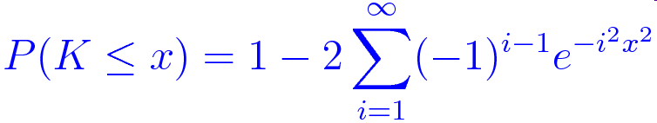
Kolmogorov distribution
For large n:
  D_{n} converges to zero (small D_{n} = good agreement)
  K=√n D_{n} has a distribution that is independent on f(x) known as Kolmogorov distribution (related to Brownian motion)
Kolmogorov distribution is:
Caveat with KS test:
  Very common in HEP, but not always appropriate
  If the shape or parameters of the PDF f(x) are determined from the sample (i.e.: with a fit) the distribution of √nD_{n} may deviate from the Kolmogorov distribution.
  A toy Monte Carlo method could be used in those case to evaluate the distribution of √n D_{n}

Slide 48

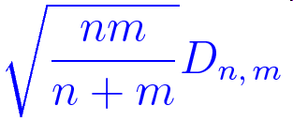
Two sample KS test
We can test whether two samples {x₁, …, x_{n}}, {y₁, …, y_{m}}, follow the same distribution using the distance:
The variable that follows asymptotically the Kolmogorov distribution is, in this case:

Slide 49
Z cross section at LHC
Plenty of Z→μμ event are produced at LHC
A precision measurement of the cross section provides a stringent test of the Standard Model prediction
Main ideas to achieve the best precision:
  Measure all detector-related (nuisance) parameters from data and avoid simulation assumptions
  Determine cross section (p.o.i.) simultaneously with nuisance parameters

Slide 50
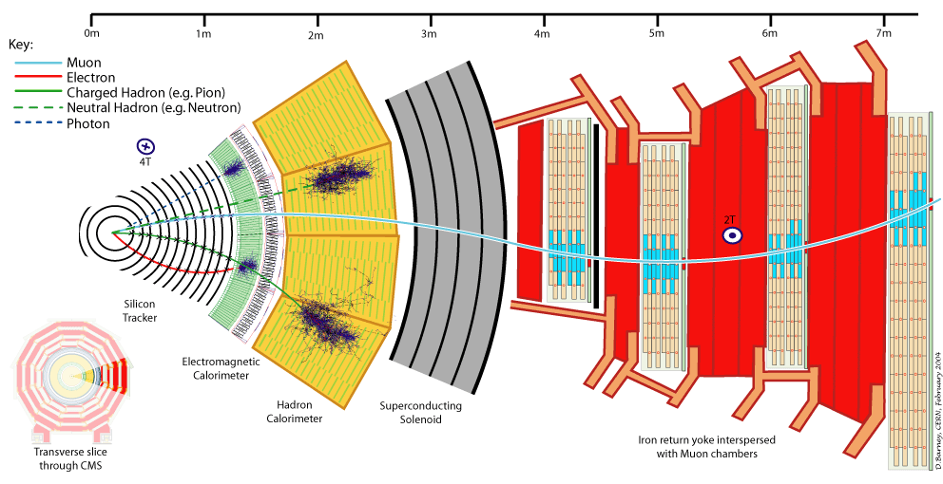
Muon reconstruction in CMS
Muons are reconstructed independently
  In the tracker (efficiency: ε_{trk})
  In the muon detector (ε_{sa})
Trigger condition is required
  Mandatory to store an the event
  Single-muon trigger required (ε_{HLT})
Muons should be isolated (ε_{iso})
  Avoid muons produced inside hadronic jets. Only tracker info is used to avoid cross-detector dependencies
Efficiency “order” is important!

Slide 51


Dimuon categories
Events with two muon candidates are separated in different categories:
  Z_{μμ}: a pair of isolated global muons, further split into two samples:
    Z_{μμ}^{2HLT}: each muons associated with an HLT trigger muon
    Z_{μμ}^{1HLT:} only one of the two muons associated with an HLT trigger muon
  Z_{μs}: one isolated global muon (HLT) and one isolated stand-alone muon
  Z_{μt}: one isolated global muon (HLT) and one isolated tracker track
  Z_{μμ}^{noniso}: a pair of global muons (HLT), of which one is isolated and the other is nonisolated
Categories forced to be mutually exclusive (i.e.: stat. independent)
The number of signal events in each category depends on the total signal yield and the various efficiency terms

Slide 52



The four categories

Slide 53
Fit model
Simultaneous fit of the four categories
Histograms estimator from Baker-Cousins Poissonian likelihood ratio (approx. χ² distribution)
Background in Z_{μμ} neglected: subtracted MC estimate
  A single bin is assumed for the two Z_{μμ}^{1HLT}, Z_{μμ}^{2HLT} categories
Invariant mass shape from Z_{μμ} category taken for all categories, except Z_{μs} (worse resolution of stand-alone muon)
The shape of Z_{μs} is taken from Z_{μμ}, but one muon’s track information is dropped
  odd/event event → lowest/highest p_{T} muon
Background shapes: exp × polynomial

Slide 54





Results

Slide 55
References
Gary J. Feldman, Robert D. Cousins, “Unified approach to the classical statistical analysis of small signals”, Phys. Rev. D 57, 3873 - 3889 (1998)
J. Friedman, T. Hastie and R. Tibshirani, “The Elements of Statistical Learning”, Springer Series in Statistics, 2001.
A. Webb, “Statistical Pattern Recognition”, 2nd Edition, J. Wiley & Sons Ltd, 2002.
L.I. Kuncheva, “Combining Pattern Classifiers”, J. Wiley & Sons, 2004.
Artificial Neural Networks
  Bing Cheng and D. M. Titterington, Statist. Sci. Volume 9, Number 1 (1994), 2-30, Neural Networks: A Review from a Statistical Perspective
  Robert P.W. Duin, Learned from Neural Networks
  http://ict.ewi.tudelft.nl/~duin/papers/asci_00_NNReview.pdf
Boosted decision trees
  R.E. Schapire, The boosting approach to machine learning: an overview, MSRI Workshop on Nonlinear Estimation and Classification, 2002.
  Y. Freund, R.E. Schapire, A short introduction to boosting, J. Jpn. Soc. Artif. Intell. 14 (5) (1999) 771
  Byron P. Roe et al, Boosted Decision Trees as an Alternative to Artificial Neural Networks for Particle Identification
  B.P Roe et al., Nucl.Instrum.Meth. A543 (2005) 577-584 Boosted decision trees as an alternative to artificial neural networks for particle identification
  http://arxiv.org/abs/physics/0408124
  Bauer and Kohavi, Machine Learning 36 (1999),
  “An empirical comparison of voting classification algorithms”

